Slide 1

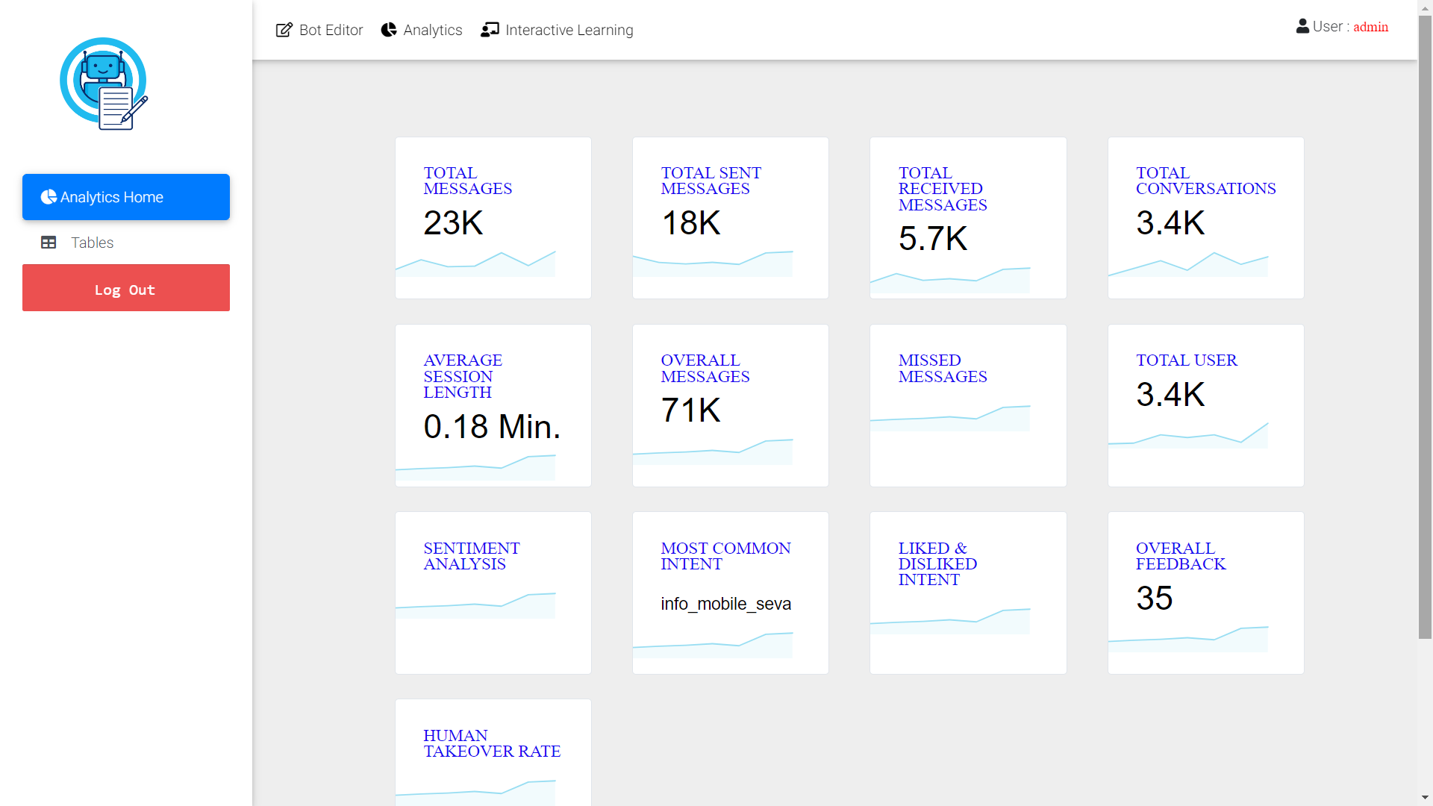
Analytics Dashboard

Slide 2
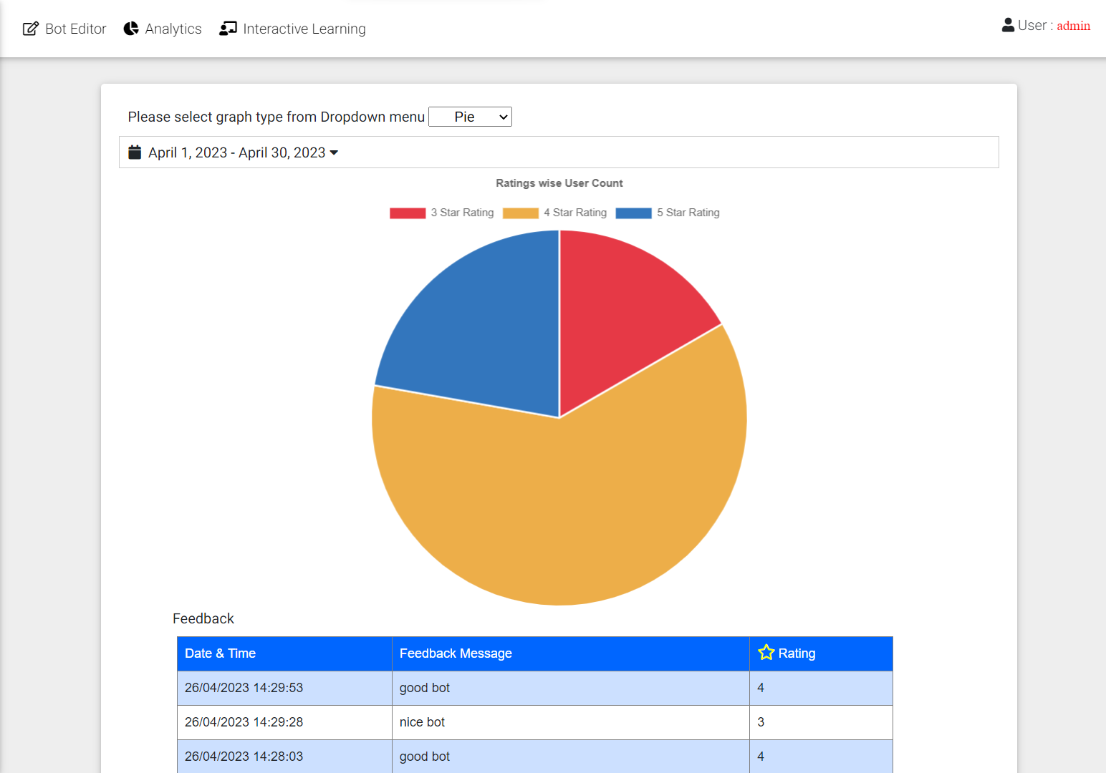
Analytics Dashboard
It displays the feedback and rating by the User for complete chat experience.

Slide 3
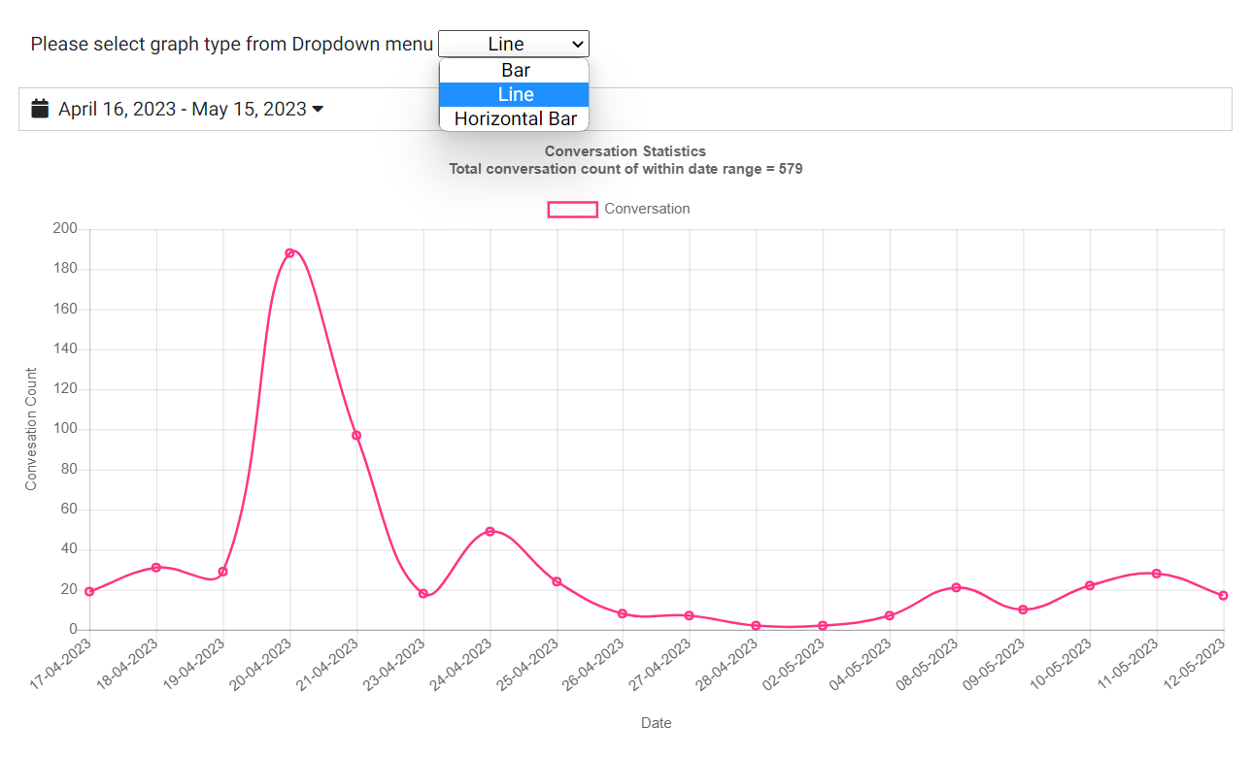
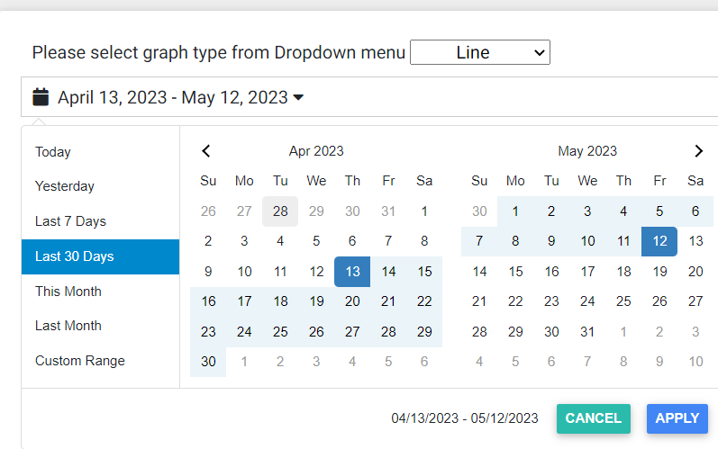
Analytics Dashboard
Dropdown allows user to select from variety of Graph-Types e.g Bar,Pie,Doughnut,Radar,Line etc
User can Analyze the data by selecting the dates from UI

Slide 4
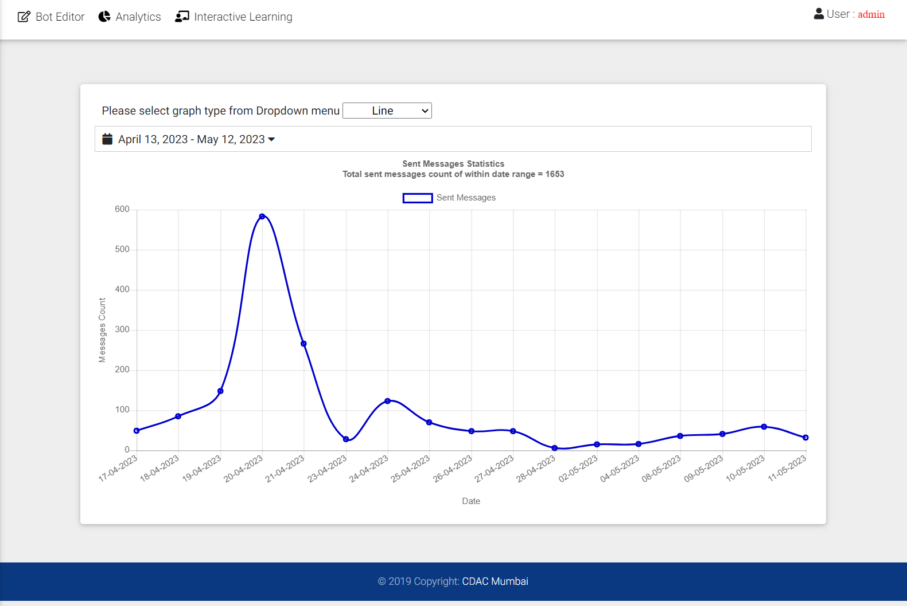
Analytics Dashboard
It is displaying the total number of messages sent by bot to the user while chatting.

Slide 5
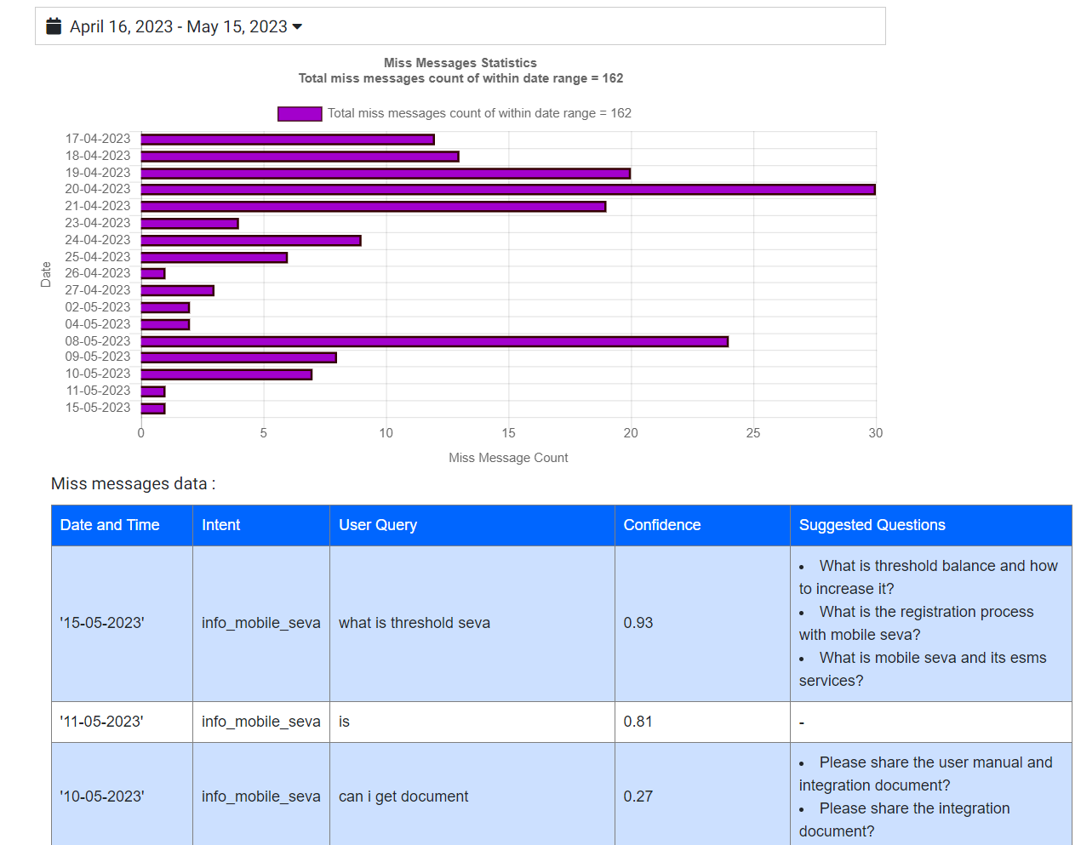
Analytics Dashboard
It keeps the record about bot does not able to respond to user query and also keeps a track of suggested question

Slide 6

Analytics Dashboard
It is displaying the sentiment of user while chatting with the bot

Slide 7
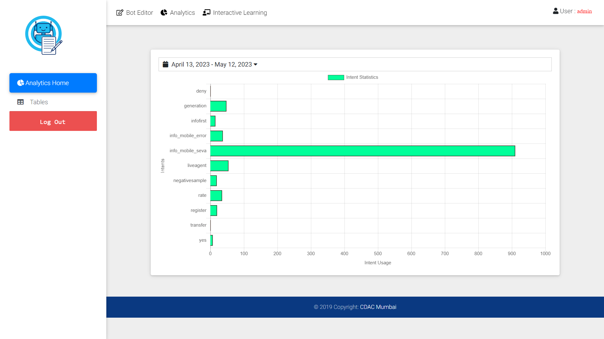
Analytics Dashboard
It is displaying the intent which is fired maximum time while chat.

Slide 8
Analytics Dashboard
Mobileseva Analytics
Sr.No | Analytics Field | Count
1) | Total Messages | 3.6k
2) | Total Sent Messages | 2.1k
3) | Total Received Messages | 1.4k
4) | Total Conversations | 430
5) | Total Users | 430
6) | Average Session Length | 0.18 Minutes
7) | Overall Messages | 7.1k
8) | Most Common Intent | info_mobile_seva
9) | Overall Feedback | 4
10) | Missed Messages | 174
11) | Liked,Disliked Messages | [735,0]

Slide 9
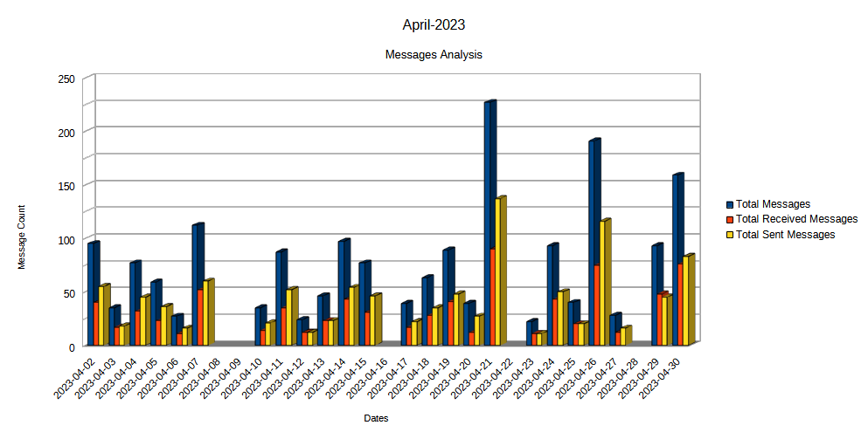
Analytics Dashboard
Mobileseva Analytics

Slide 10
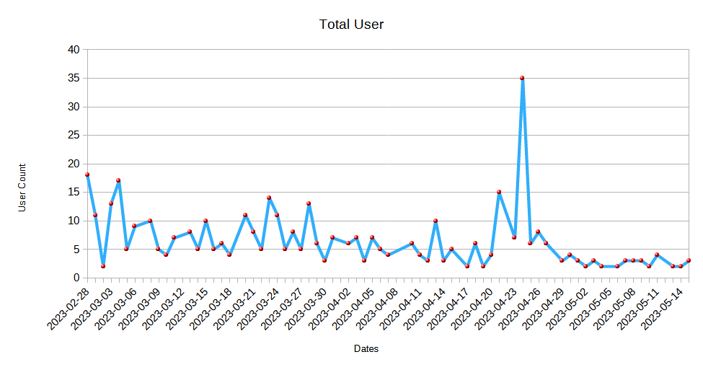
Analytics Dashboard
Mobileseva Analytics

Slide 11
Analytics Dashboard
Mobileseva Analytics
Month Wise Messages Count
Sr.No | Total Messages | Total Received Messages | Total Sent Messages
March-2023 | 1469 | 573 | 896
April-2023 | 1854 | 806 | 1048
May-2023 | 146 | 65 | 81

Slide 12
Analytics Dashboard
ePramaan Analytics
Sr.No | Analytics Field | Count
1) | Total Messages | 1.6k
2) | Total Sent Messages | 1k
3) | Total Received Messages | 633
4) | Total Conversations | 171
5) | Total Users | 171
6) | Average Session Length | 0.27 Minutes
7) | Overall Messages | 4k
8) | Most Common Intent | info_user
9) | Missed Messages | 133

Slide 13
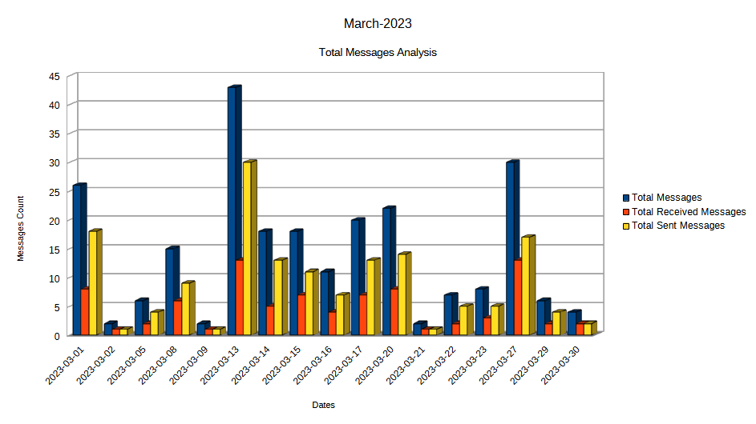
Analytics Dashboard
ePramaan Analytics

Slide 14
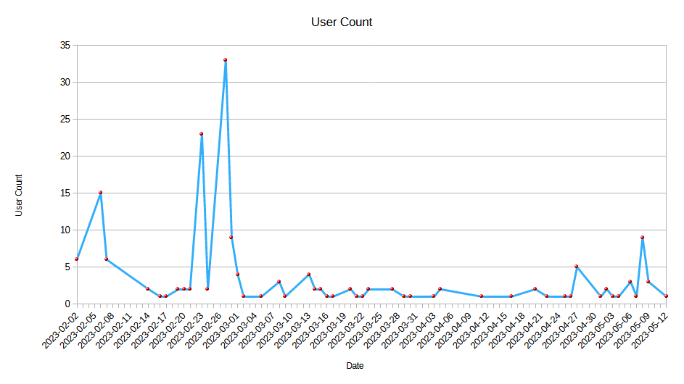
Analytics Dashboard
ePramaan Analytics

Slide 15
Analytics Dashboard
ePramaan Analytics
Month Wise Messages Count
Sr.No | Total Messages | Total Received Messages | Total Sent Messages
Feb-2023 | 1121 | 427 | 694
March-2023 | 240 | 85 | 155
April-2023 | 170 | 61 | 109

Slide 16
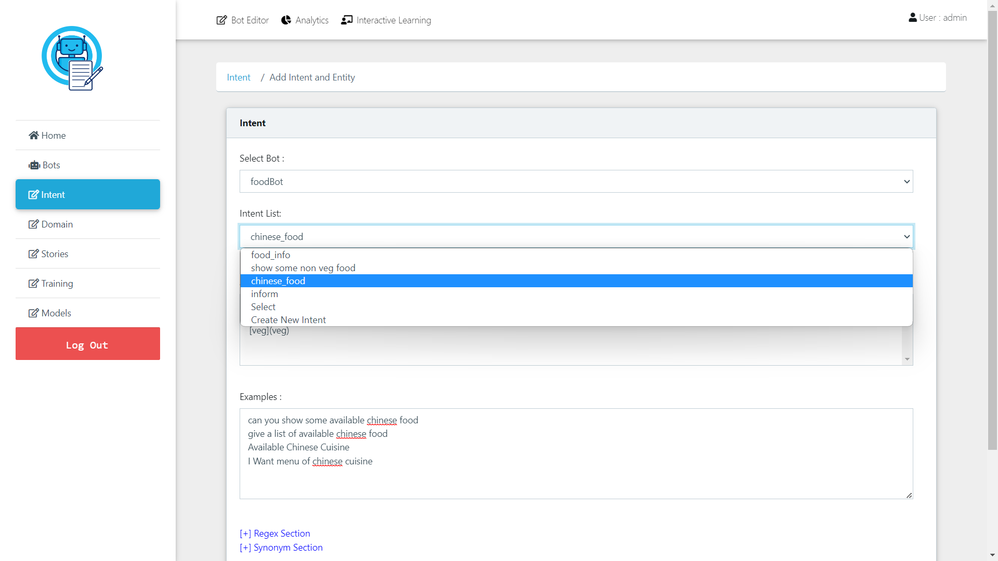
Editor
Allows user to create and edit intent file from UI with the necessary syntax.

Slide 17
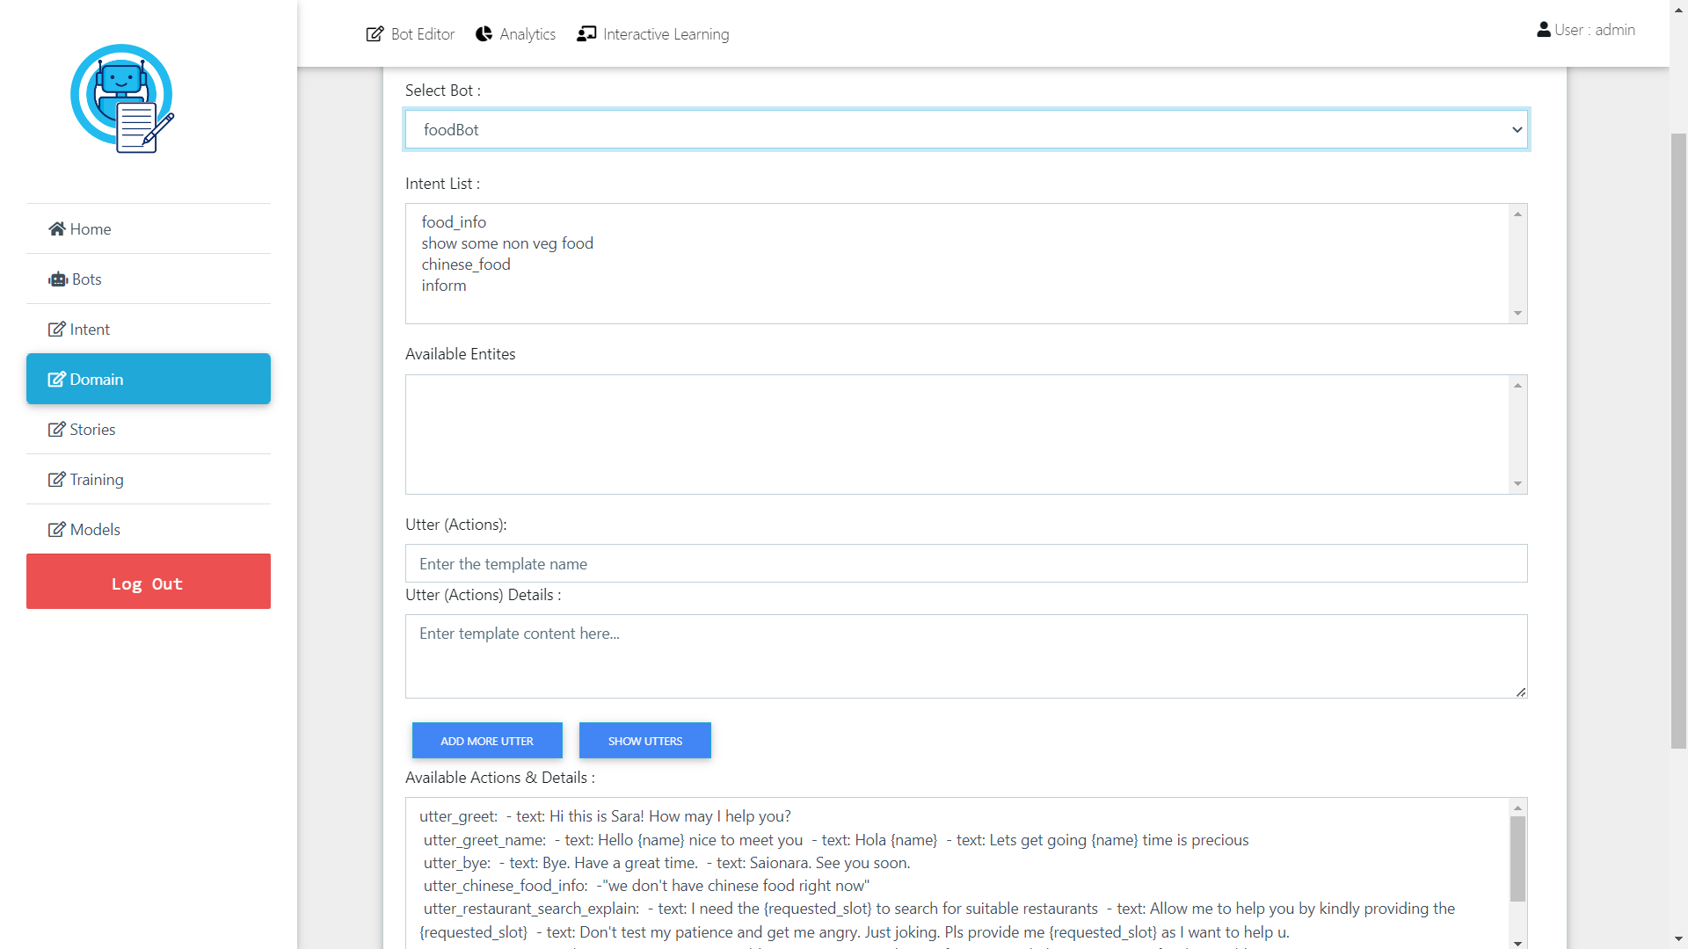
Editor
Allows user to create and edit Domain file from UI with the proper Syntax.

Slide 18
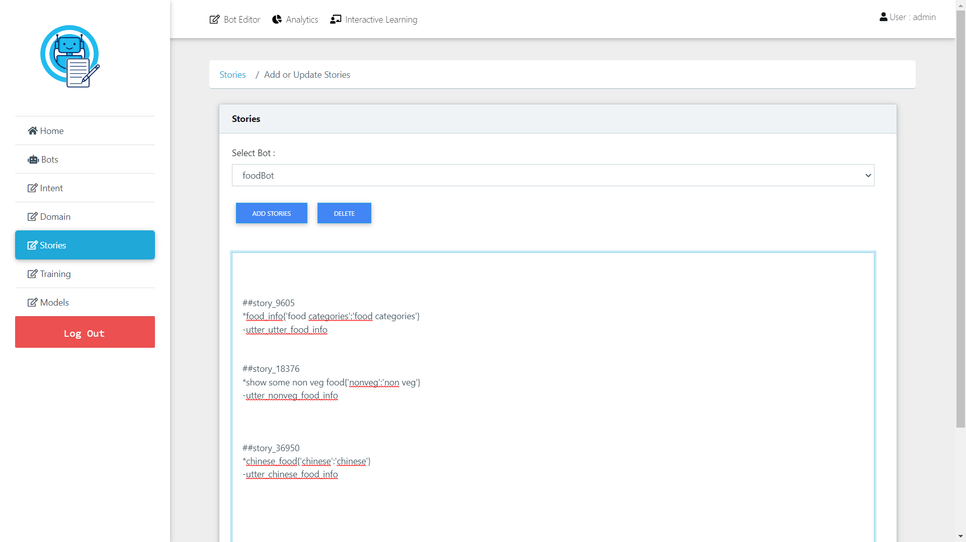
Editor
Allows user to create and edit Stories file from UI with the necessary syntax.

Slide 19
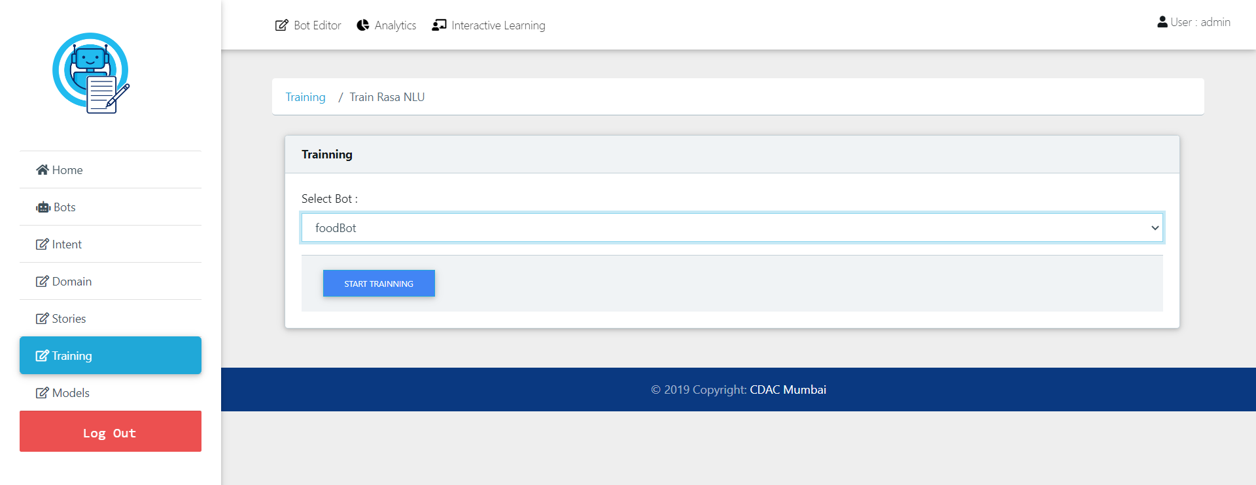
Editor
Allows user to train the bot after file creation from UI.

